Slide 1
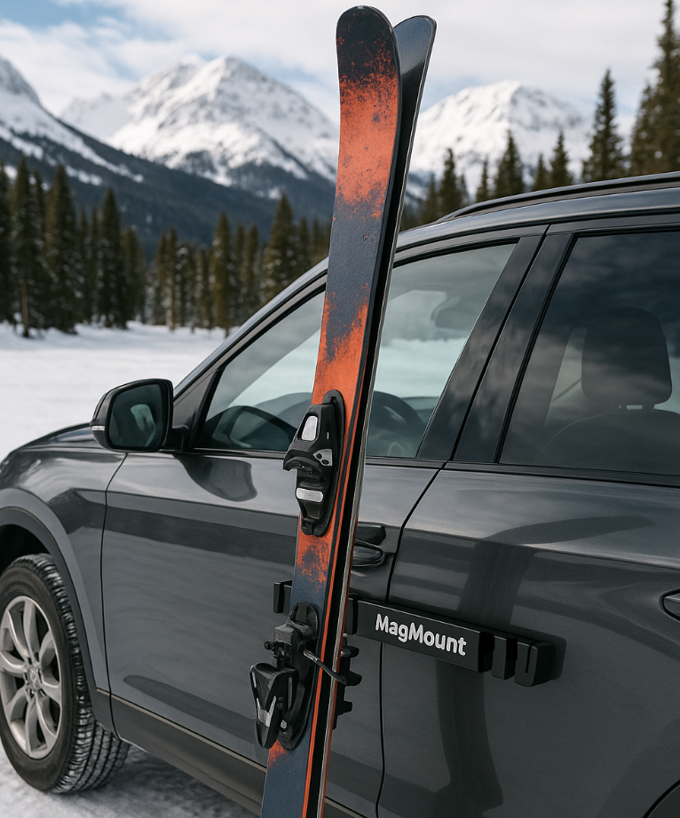
Ski Days Shouldn’t Start with Scratches
80% of skiers that drive to resorts struggle with gear transitions in icy parking lots.
Notes:
Picture this: You’ve driven up for a big ski day and just pulled your skis off the rack—but there’s nowhere safe to put them. They fall, scratch your car, or worse. That’s where MagMount comes in: an easy, secure solution to a very common ski-day headache.

Slide 2
The Problem
No stable place to rest skis while booting up
Skis fall, scratch paint, or break
Current solutions are expensive, bulky, or nonexistent
45% of surveyed skiers report frustration with gear setup
Notes:
Here’s the problem. Skiers don’t have a good place to rest their skis during transitions, especially in icy parking lots. This leads to broken gear, scratched paint, and a frustrating start to the day. Current solutions are either way too expensive or not practical, and our survey confirmed that 45% of skiers are unhappy with this process.

Slide 3
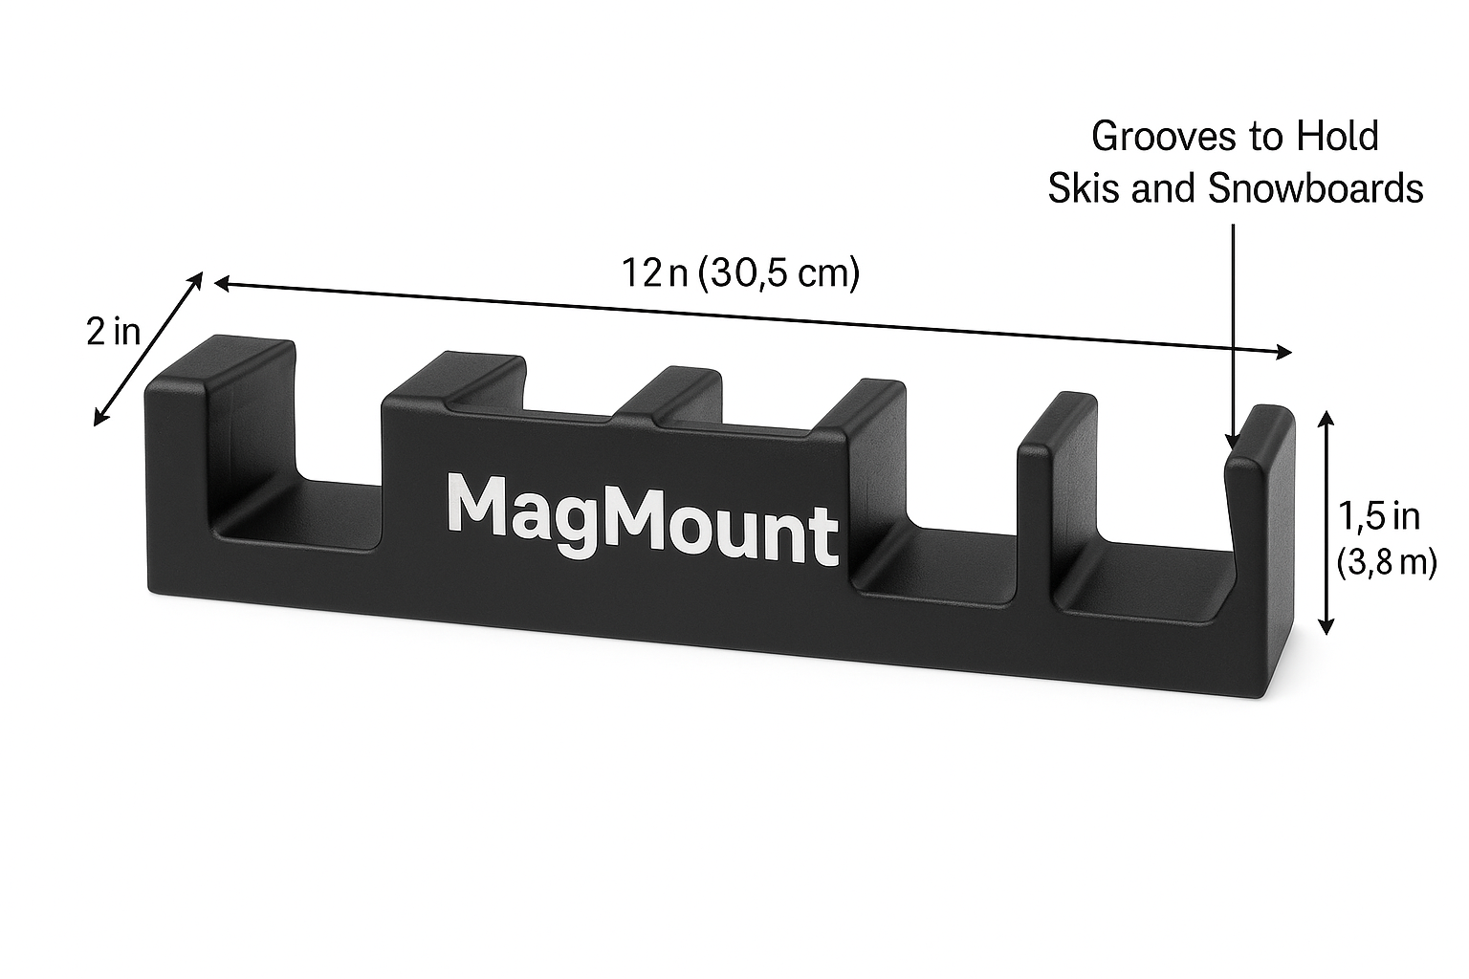
The Solution – MagMount
Compact, magnetic ski rest
Non-scratch rubber backing
Lightweight, weatherproof, glovebox-sized
Built by skiers, for skiers
Notes:
Our solution is MagMount: a durable, weather-resistant, compact ski holder that magnetically attaches to your car. It’s safe for paint, quick to use, and fits in a glovebox. It’s made by skiers, for skiers—so we knew the design needed to be rugged, simple, and affordable.

Slide 4
Target market
Gen Z & Millennials
Recreational skiers
Value gear & convenience
Tech-savvy, social
Notes:
We’re targeting recreational skiers, especially Gen Z and Millennials, who care about gear and convenience. These skiers are tech-savvy, socially connected, and love outdoor products that solve real problems. We’re starting with a geographic focus on Colorado and Utah

Slide 5
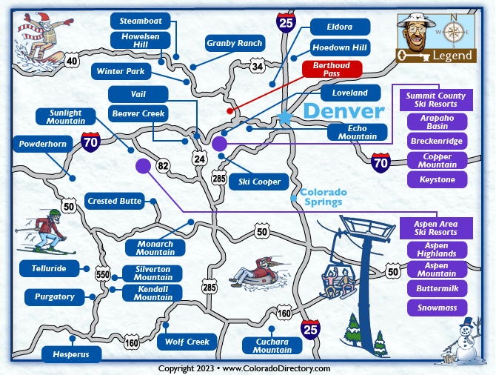
Market Size
TAM: $1.2B global ski accessories
SAM: $180M U.S. ski support market
SOM: $2.5M – 5% of CO/UT skiers
Notes:
Let’s talk market size. The total global ski accessories market is worth $1.2 billion. In the U.S., we’re looking at a $180 million ski support market. Our initial obtainable market is about $2.5 million, targeting just 5% of skiers in high-traffic states like Colorado and Utah. This gives us a strong base to grow from.

Slide 6
Market Validation
18.5M U.S. skiers in 2023
71% survey respondents dislike current gear setup
20+ interviews at resorts confirm the pain point
Competitor gap: SnoStrip is $50+, bulky, rare
Notes:
We validated this idea with over 30 survey responses and 20 +interviews in ski lots. 71% of respondents said they were frustrated by current gear setup processes. Our key competitor, SnoStrip, sells a similar idea, but it’s over $50 and hard to find. That leaves a big gap we’re ready to fill.

Slide 7
Marketing Strategy
D2C via Shopify and Amazon
Social media: TikTok/Instagram influencers
Resort popups, ski shop partnerships
Loyalty: referrals, brand ambassadors
Notes:
Our marketing strategy is built around where skiers already spend time. We’ll sell online via Shopify and Amazon. Our outreach will focus on Instagram and TikTok influencers, as well as snow sports communities, such as pop-ups at ski resorts and partnerships with shops in ski towns. Loyalty programs and ambassador marketing will help us grow long-term.

Slide 8
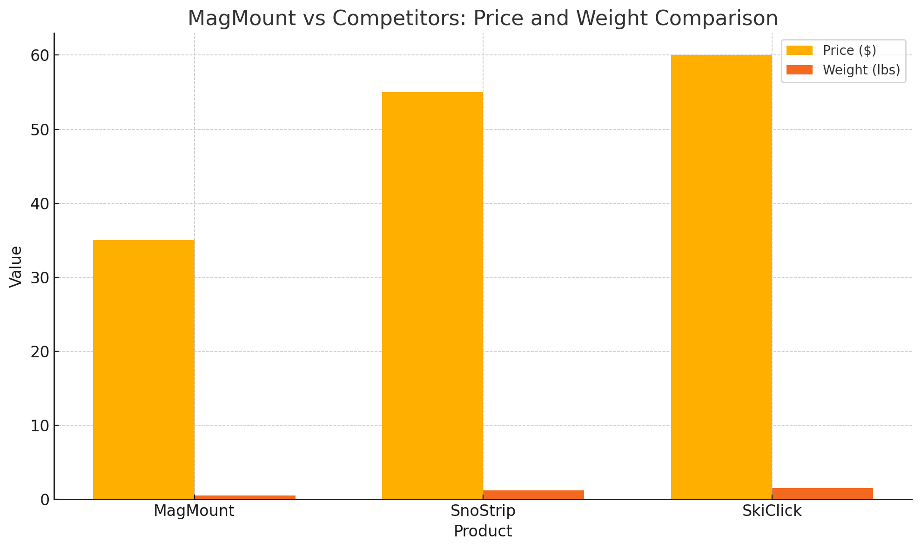
Competitive Advantage
Injection-molded ABS plastic: lightweight, durable, low-cost
Weatherproof, glovebox-sized, installs in seconds
Tailored for lifestyle skiers, not just gearheads
Notes:
First, MagMount is made from injection-molded ABS plastic—this material is lightweight, durable, weather-resistant, and most importantly, extremely cost-effective to manufacture at scale. This lets us keep production costs low—around $10 per unit—which supports a strong retail margin.
Second, the product is practical: it’s small enough to fit in your glovebox, completely weatherproof, and installs in seconds. Unlike bulky alternatives, ours is designed with the casual skier in mind—not just gearheads who obsess over equipment.
Lastly, the chart shows how we stack up against competitors like SnoStrip and SkiClick. While they’re priced around $55–$60 and add weight to your setup, MagMount comes in cheaper and lighter, without compromising functionality. That combination makes us stand out for everyday skiers looking for convenience and value.
ABS: Acrylonitrile Butadiene Styrene.
It's a strong, lightweight, and heat-resistant thermoplastic polymer

Slide 9
Business Model & Financials
Retail Price: $35 | COGS: ~$10
Startup Budget: $20,000
• 40% prototyping
• 30% marketing
• 20% inventory
• 10% legal/IP
Breakeven at 300 units sold
Notes:
MagMount is built to be capital-efficient and scalable. With a production cost of about $10 and a $35 retail price, we’re operating on strong margins, which gives us room to grow and invest in quality, marketing, and customer experience.
Our initial startup budget is $20,000, strategically allocated: 40% to prototyping for testing and refining the design, 30% to marketing to capture early adopters, 20% toward inventory so we’re ready for launch, and 10% to legal and IP protection to secure our innovation.
What’s exciting is that we only need to sell 300 units to breakeven. That’s one solid ski season in Colorado or Utah. We’ve designed this with realistic, achievable milestones that set us up for sustainable scaling.”

Slide 10
Closing & Call to Action
We’re asking for $20,000 in seed capital for launch, manufacturing, IP protection, and marketing.
ROI: 3x in 18 months.
“Let’s give every skier a smarter way to start their day.”
Notes:
To bring MagMount to life, we’re asking for $20,000 in seed capital. This covers the most critical pieces of our launch: prototyping, protecting our IP, marketing to build awareness, and producing our first run of inventory.
Based on our pricing, cost structure, and target market size, we’re forecasting a 3x return on investment in just 18 months. This isn’t just a product — it’s a smart solution to a problem millions of skiers face.
Our vision is simple: Let’s give every skier a smarter way to start their day. With your investment, we’re ready to hit the slopes, and the market

